Slide 1
Social inclusion techniques in vocational education training
SITinVET European Dissemination Conference
8th – 10th May 2014,
Bolu, Turkey
Project Leonardo da Vinci Partnerships 2012 – 2014
BIOSPEKTRUM NGO, SLOVAKIA

Slide 2
BIOSPEKTRUM NGO
Was founded in 2006 in Rožňava,
A non-governmental, non-profit organization,
Providing education and training for learners of all ages – children, students, adults, general public, including a group of disadvantage people and socially excluded groups,
Providing education, consulting and information services focused on any aspect of lifelong learning

Slide 3
What we do
education in the field of education for SD, by using new techniques and the best European practices acquired during cooperation with many international organizations in European projects focused on environmental sustainability and healthy lifestyle,
providing consulting for organizations in field of environmental management,
training focused on improvement of key competences for environmental sustainability,
active participation in cooperation with international organizations on environmental issues and education for sustainable development,

Slide 4
What we do
presentation of actual environmental and ecological problems in the context of environmental sustainability,
educational activities for adults, youths and children – outdoor activities, seminars, workshops and guided walks focused on environmental sustainability, healthy environment, environmental management, integrated management of protected areas, heritage education, forest education, values education, etc.,
cooperation with the University of Matej Bel in Banská Bystrica (Faculty of Natural Sciences, Department of Environment), the State Nature Conservancy of the Slovak Republic, the Slovak Museum of Nature Protection and Speleology and the Blind and Visually Impaired Union.

Slide 5
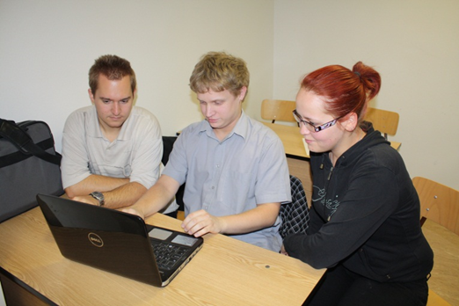
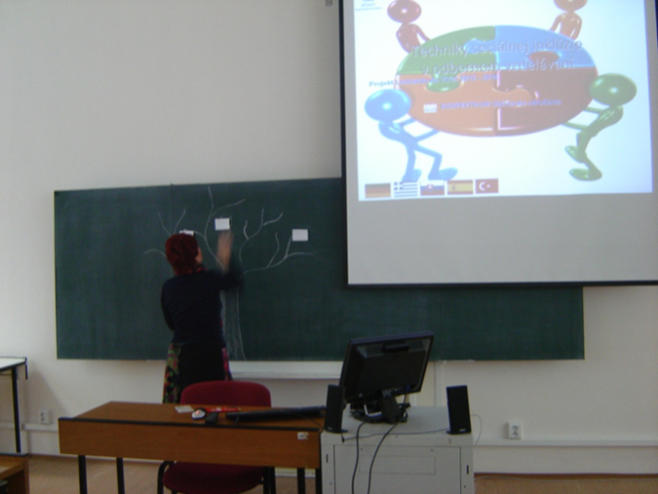
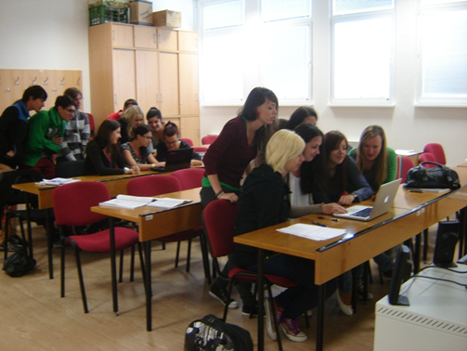
SITinvet project 2012 - 2014
1st workshop
“PEER EDUCATION” – within a group of students of ICT lessons
Selected activity:
“PHOTOSHOP”

Slide 6
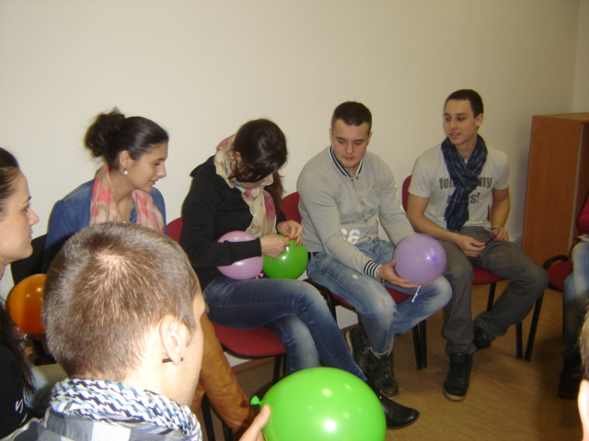
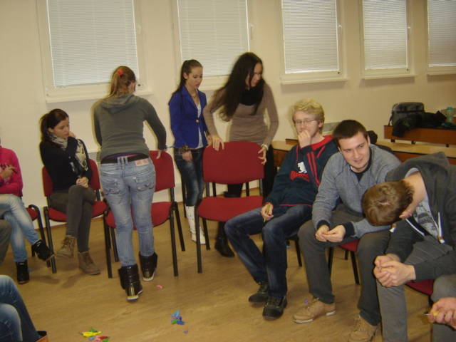
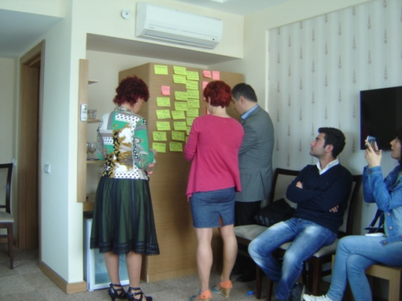
SITinvet project 2012 - 2014
2nd workshop
“Balloons” - solving the problem, reflecting about the mechanisms of exclusion and discrimination, to encourage follow up activities
Selected problem:
“communication improvement”

Slide 7
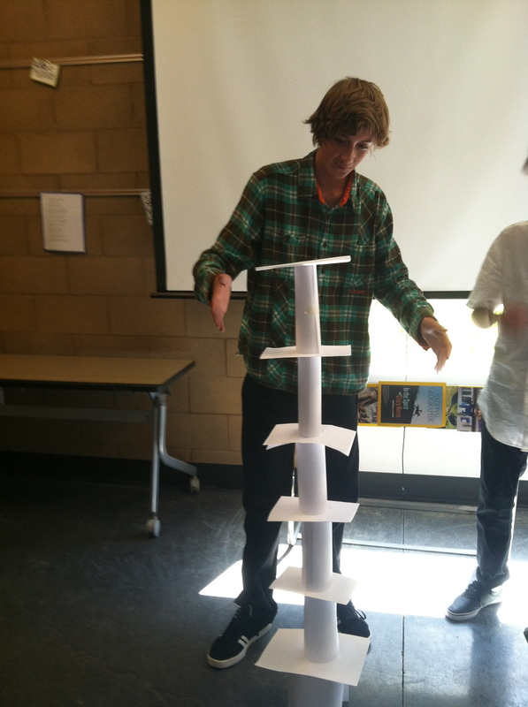
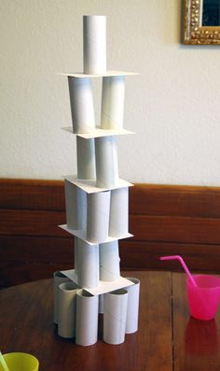
SITinvet project 2012 - 2014
3rd workshop
“Tower” - team building technique

Slide 8
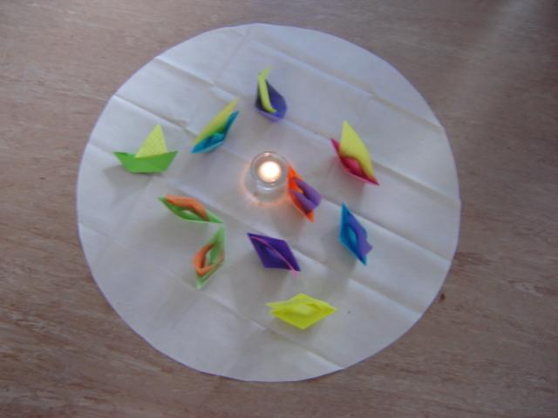
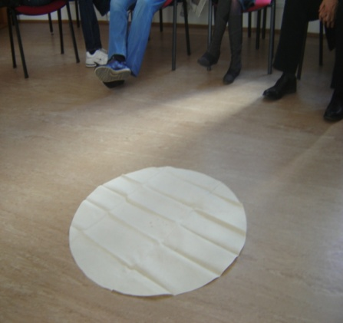
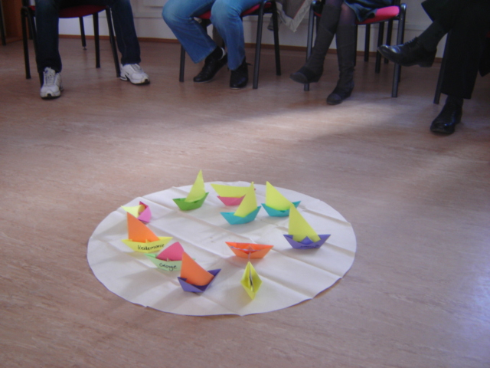
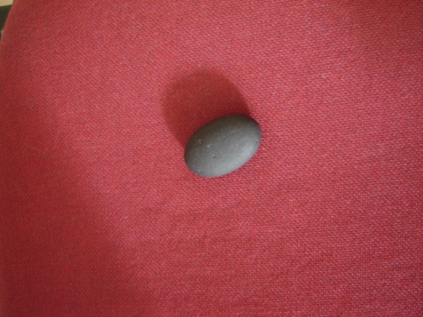
SITinvet project 2012 - 2014
4th workshop
“The Teamship” – team building activity, starting activity

Slide 9
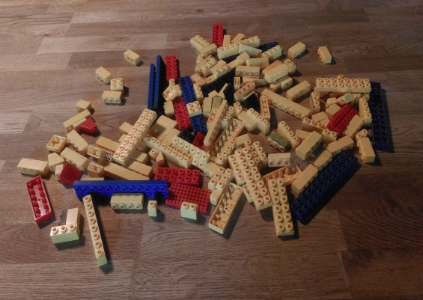
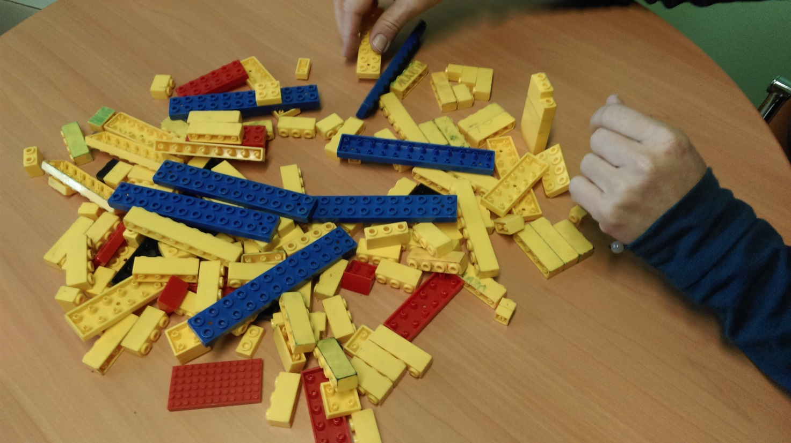
SITinvet project 2012 - 2014
5th workshop
“Lego” – team building activity

Slide 10
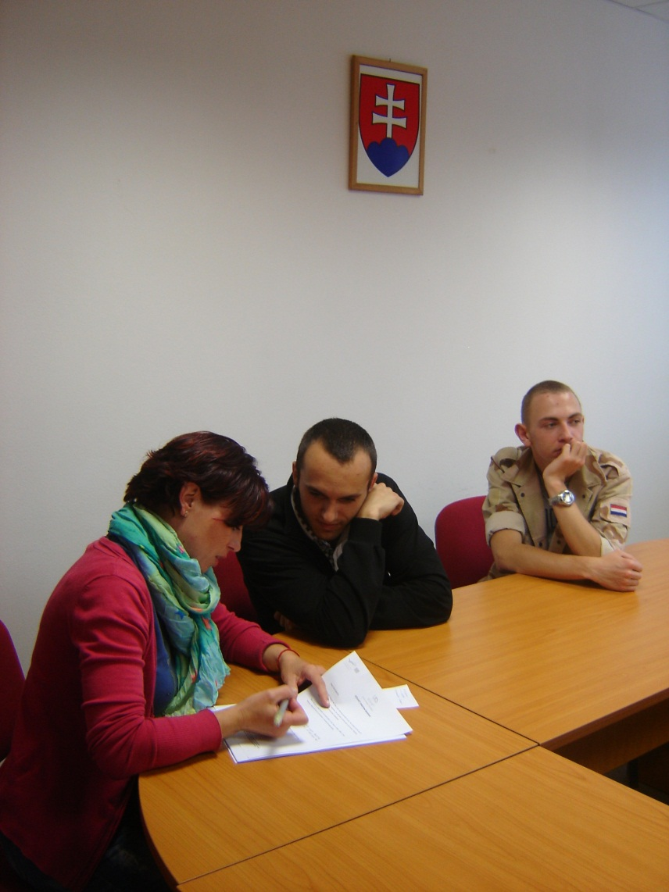
feedback – questionaire for students

Slide 11
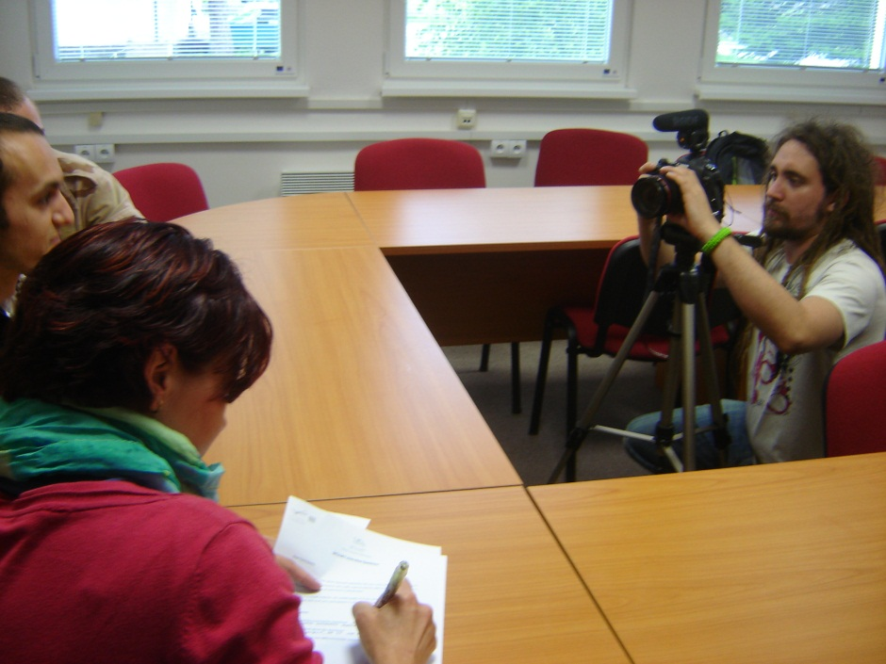
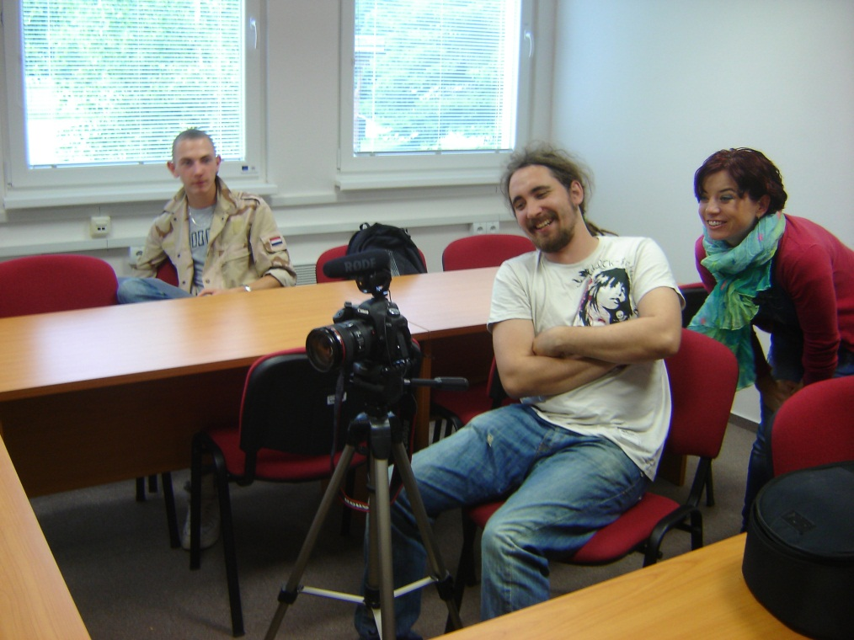
Interview of students

Slide 12
Dissemination activities on local and national level:

Slide 13
Dissemination activities on local and national level:

Slide 14
Dissemination activities on local and national level:

Slide 15
Dissemination activities on local and national level:

Slide 16
Dissemination activities on local and national level:

Slide 17
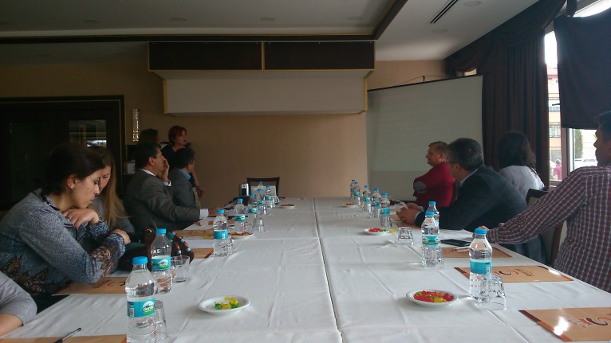
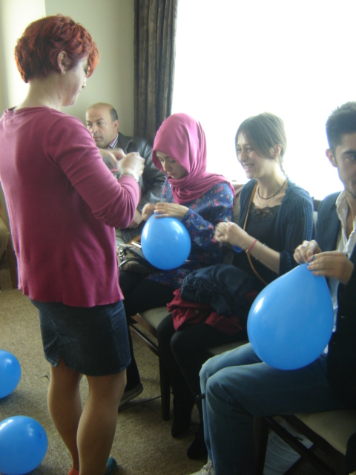
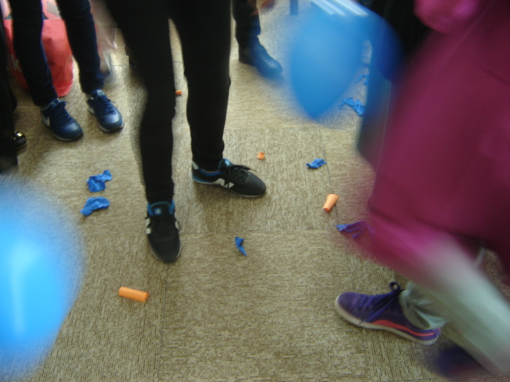
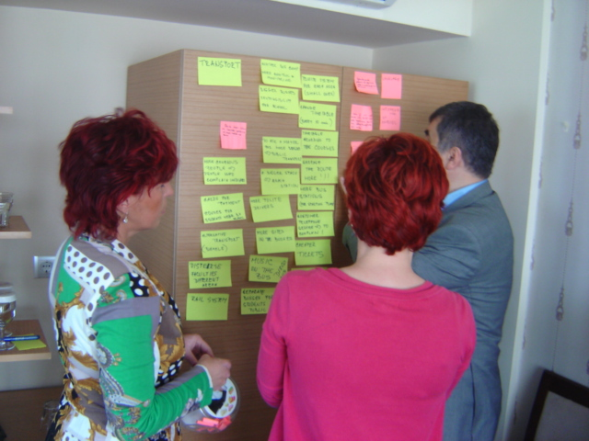
Dissemination activities on international level:
“Dissemination conference in Bolu (Turkey)” – presentation of good practice from Slovakia – social inclusion technique „Balloons“

Slide 18
Thank you for your attention

